Slide 1



How to save the world while programming?
7 ‘tips’ on sparing CPU cycles
Juanmi Huertas
R&D Software Engineer
Color and Imaging team
HP
Notes:
Well, this is a talk I made for one of the sessions of C++ that we have been doing (and that we want to restart, by the way). Then I’ve modified this talk for a meeting I went to Madrid, and this is the third iteration of these slides.

Slide 2
Introduction*
Seven topics to know to better use the CPU in your applications
But… why do we care about CPU?
* Disclaimer: This talk may contain some traces of C++ and/ maths. In case of allergy talk to your closer software engineer.
/40
Notes:
So this talk is about using less CPU in your applications, some theoretical and practical tips, taken from Computer Science and the Games Industry, that can help you to make your applications to use your CPU.
But, what are the reasons to use less CPU? What do we think is so bad of how we usually develop applications?
Speed. Throughput. ENERGY.
Mainly energy. If we use less CPU in our applications, if we make “faster” applications, if we produce our data in less time, we can reduce the use of energy, and hence, save the world (that´s the motivation of the title of this talk).
But now, let´s get into business.

Slide 3
1) Know your tools
, C, C++, Java, Python, Smalltalk, C#, LISP, openGLSL, CUDA...
C++… 98? 11? 14? 17? Lambda, Auto, &&, Variant,…
Learn! Cppcon, JavaOne, PyCon...
Language
Compiler
, virtual machine? Just in time compilation?
C++… gcc? Mvisual? Clang? CLANG!
Do not help the compiler!
We code for:
hardware,
peers,
future you.
/40
Notes:
This may sound a bit silly, but, do you REALLY know the language that you are using?
Languages are just tools.
And maybe more important, do you know WHEN to use on or another?
Sometimes we choose the wrong tool to sort a problem. And hence we create more problems!
And it is not only about “do I know already how to use it?” but more “do I know which one to use?”. And if I don´t know that language…
It does harm nobody to learn more tools.
Then we have to know why are we writing code, usually, for a compiler, or a virtual machine, or some component in the machine that will “run” our program. Do we know how does it work? Do we know what we can do with it?
And also… avoid trying to help it. The compiler is usually smarter than you.
And then, extra thing. We write our code not only for the compiler. We write it as well for our colleges, and for the “future me”. Sometimes I forget where do I leave the keys when I get home, I don´t expect to know exactly why did I wrote that line of code.

Slide 4
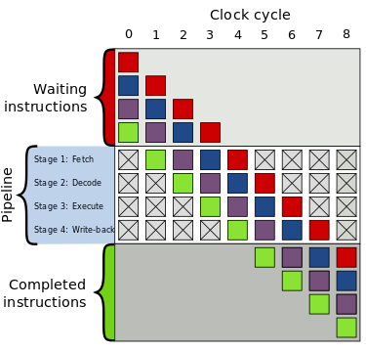

2) Know your hardware: CPU
“The only bad thing about theoretical computing is that there are no theoretical computers.” Andy Thomason.
CPU pipeline
Do not help the compiler!
But don’t sabotage it!
/40
Notes:
Well. We know our tools. Now we need to know where this code is going to be “run”.
This is a quote from one professor I met in London, he used to be a compiler expert for Sony and Playstation.
Now I will oversimplify a bit, but, don´t forget that a CPU is something like this. Is just a pipeline, were you will have different stages where every instruction is going to be executed. It may even need some data, that has to go there.
The CPU is very good at anticipating what is going to be the next instruction, so it’s good not to try and help it, but, don´t sabotage it neither!

Slide 5
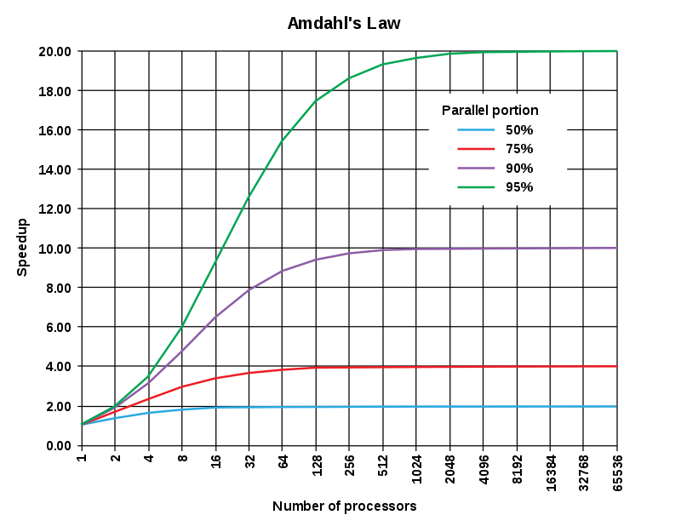
2) Know your hardware: CPU
“The only bad thing about theoretical computing is that there are no theoretical computers.” Andy Thomason.
CPU pipeline
Do not help the compiler!
But don’t sabotage it!
Concurrency.
/40
Notes:
Then, you may think, my program is slow. It is slow because I´m tricking my CPU, so… lets put hundreds of those! (Like a GPU).
You could expect some behaviour like this…

Slide 6
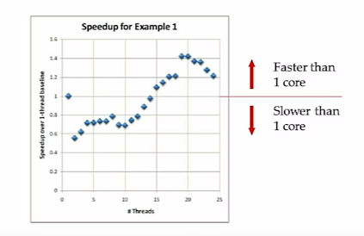
2) Know your hardware: CPU
“The only bad thing about theoretical computing is that there are no theoretical computers.” Andy Thomason.
CPU pipeline
Do not help the compiler!
But don’t sabotage it!
Concurrency?
/40
Image taken from a talk of Herb Sutter and Scott Meiers on concurrency and C++11.
Notes:
But usually it is something like this. You throw threads and cores to your problem, and you don´t get an improvement, actually, some times you may even make it slower.
There are some elements as shared data, or shared pipelines, that can affect our performance, actually…

Slide 7
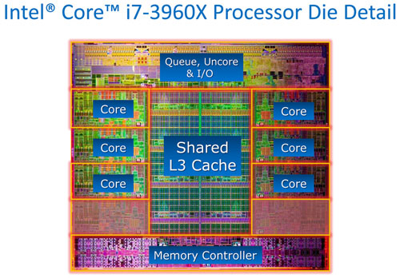
2) Know your hardware: CPU
CPUs are fast:
1.000.000.000 cycles/second
12+ cores per socket
3+ execution ports per core
36.000.000.000 instru/second
/40
Notes:
The CPUS are fast.

Slide 8
2) Know your hardware: CPU
CPUs are too fast:
1.000.000.000 cycles/second
12+ cores per socket
3+ execution ports per core
36.000.000.000 instru/second
Waiting for data!
/40
Notes:
TOO FAST.
The CPU will always be waiting for data. So, if you share some data from any of you cores, you are effectively making your CPU slower!

Slide 9
2) Know your hardware: CPU
CPUs are too fast:
1.000.000.000 cycles/second
12+ cores per socket
3+ execution ports per core
36.000.000.000 instru/second
Waiting for data!
‘Pipeline’ of instructions.
BAD, aliasing is bad - prefetch
BAD, concionals are bad - taking decisions beforehand
BAD, virtualization is bad - vtable=alias
Multi-threading, not necessarily better!
Threads may share the cache. Caution!
/40
Notes:
And there is not a single bullet to sort out all the problems of the CPU. Some hints may be that aliasing can be bad (sometimes you name a same variable with different names, aka pointers to the address), the CPU then must re-fetch the data, just in case it was changed in other thread. Conditionals can be very bad, as, in case that are bad predicted, you may waste calculations in your pipeline. Virtualization is nothing more than an alias, so extreme polymorphism can be even damaging to extremely critical pieces of the code…
But, the most important thing of this slide is: CPUS are fast and are waiting for data. And think about the CPU like a clever pipeline of instructions. Compilers are good at translating your code to something nice for the cpu (and that’s why sometimes virtual machines can perform better than compiled code).

Slide 10
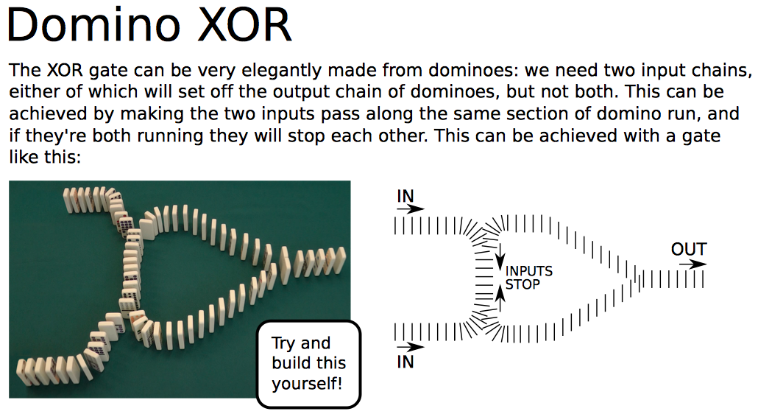
3) Know your hardware: Memory
CPUs are too fast:
Waiting for data!
“The only bad thing about theoretical computing
is that there are no theoretical computers.”
Andy Thomason.
Jeff Dean numbers.
Cache speed & size comparison.
/40
Notes:
Now, we embrace the fact that the CPU is very fast and it’s waiting for data.
Repeating this mantra from my professor… just imaging that sometimes our data can be slow, and it has to travers long distances (just imagine a computer made of dominos).
So, how slow is our data?
I’ll show you some numbers, and then I’ll do a visual comparison of the speed. ‘Cause powerpoint.

Slide 11
3) Know your hardware: Memory
Latency Comparison Numbers
--------------------------
L1 cache reference 0.5 ns
Branch mispredict 5 ns
L2 cache reference 7 ns 14x L1 cache
Mutex lock/unlock 25 ns
Main memory reference 100 ns 20x L2 cache, 200x L1 cache
Compress 1K bytes with Zippy 3,000 ns 3 us
Send 1K bytes over 1 Gbps network 10,000 ns 10 us
Read 4K randomly from SSD* 150,000 ns 150 us ~1GB/sec SSD
Read 1 MB sequentially from memory 250,000 ns 250 us
Round trip within same datacenter 500,000 ns 500 us
Read 1 MB sequentially from SSD* 1,000,000 ns 1,000 us 1 ms ~1GB/sec SSD, 4X memory
Disk seek 10,000,000 ns 10,000 us 10 ms 20x datacenter roundtrip
Read 1 MB sequentially from disk 20,000,000 ns 20,000 us 20 ms 80x memory, 20X SSD
Send packet CA->Netherlands->CA 150,000,000 ns 150,000 us 150 ms
Jeff Dean
numbers!
/40
Note: These numbers are not perfectly accurate, and they don’t intent to be. The order of magnitude are accurate, though.

Slide 12
3) Know your hardware: Memory
Speed comparison
(to scale, duh!)
CPU
L1
L2
L3
MM
/40
Inspired in ‘Data-oriented desing and C++’. Mike Acton. Cppcon’14.
Notes:
Latency:
Main memory: 107 ciclos.
Cache L3: 39 ciclos.
Cache L2: 11 ciclos.
Cache L1: 4 ciclos.

Slide 13
3) Know your hardware: Memory
CPUs are too fast. Waiting for data!
The level 1 cache is too fast. The main memory is BORINGLY slow.
Main memory: 100MB
DATA + CODE!
L1
L2
L3
Data that fits the cache, compact data, and data contiguous in memory.
Code that fits the cache, compact code, and code contiguous in memory.
/40
Notes:
Capacidades:
100MB (codigo y datos) en memoria.
8% entra en la cache L3.
0.25% entra en la cache L2.
0.03% entra en la cache L1.

Slide 14
Things to know, so far…
Know your tools
Knowledge on language, compiler…
Know your hardware: CPU
CPUs are TOO fast.
Know your hardware: memory
L1 cache is fast, main memory is very slow.
/40
Notes:
So far we’ve seen something more theoretical, now we will see something a bit more practical…

Slide 15
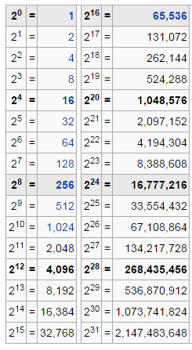
4) Know your numbers
Back-of-the-envelope calculations:
Powers of 2.
Size_of: int, float, char...
Size of cache (Jeff Dean numbers).
Combinatory.
Geometrical mathematics.
<Name your own maths>.
Example: 2²⁴ = ?
2²⁴ = 2¹⁰ * 2¹⁰ * 2⁴ =
⋍ 1000 * 1000 * 2⁴ =
= 1000 * 1000 * 16
2²⁴ ⋍ 16.000.000
/40
Notes:
This will help you to better reason when you are handling some problems. This are some maths good to have. I would like to encourage the powers of two with an example…

Slide 16
4) Know your numbers
Let’s play.
How to know if two spheres collide with each other?
Implement a method to detect collisions between two spheres.
float radius;
bool doCollide(point3d s1, point3d s2){
float distance = sqrt( (s1.x-s2.x)^2 + (s1.y-s2.y)^2 + (s1.z-s2.z)^2 );
return distance < radius * 2;
}
/40
Notes:
And now, this is a tipical interview question for some games companies. And I think this covers a bit of knowledge of applications. Any suggestions? Just without any extra and complex data structure…
An initial answer could be just the euclidean distance, and then check with the double of the radius.

Slide 17
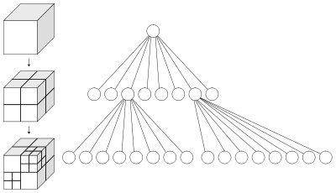
4) Know your numbers
Let’s play.
How to know if two spheres collide with each other?
Implement a method to detect collisions between two spheres.
Good data structures?
float radius;
float two_radius_square;
bool doCollide(point3d s1, point3d s2){
float distance_square = (s1.x-s2.x)^2 + (s1.y-s2.y)^2 + (s1.z-s2.z)^2;
return distance_square < two_radius_square;
}
/40
Notes:
But we could do it better. If we remove the square root (a tipically expensive operation) we can make a faster way to check if two spheres collide.
And yes, we could use a fancy data structure, but, at the end, we would have to check if two spheres collide.

Slide 18
5) Know your algorithms
Computer science?
/40
Notes:
And now, the second most fun part of this talk.

Slide 19
5) Know your algorithms
Efficiency through algorithms
“How much work does it take to do a task”
Improve efficiency by doing less work.
int find(vector<int> vec, int value); //17?
2 | 4 | 24 | -1 | 18 | 7 | 6 | 5 | 11 | 8 | 10 | 21 | 15 | 17 | 20
-1 | 2 | 4 | 5 | 6 | 7 | 8 | 10 | 11 | 15 | 17 | 18 | 20 | 21 | 24
/40
Inspired in ‘Efficiency through algorithms and performance through data structures’. Chandler Carruth. Cppcon’14.
Notes:
We have here the concept of “big O notation”. This way to express how “efficient” is an algorithm. But we could understand efficiency as “how much work does it take to do a task”.
Therefore the best way to improve the efficiency of an applications, is reducing the ammount of work we have to do.
For instance. We have to implement an algorithm that would find an element in a vector. How would you do it?
We could search one by one, in that way we should check ALL of them, to be sure that an element is present or not. So we would have a linear efficiency.
Now imagine that we have a sorted vector… We can do that work only ONCE for all of the “find” calls we will make. And then to find it, we can use a binary search.
We are doing less work to solve the same problem. BETTER EFFICIENCY.

Slide 20
5) Know your algorithms
Example: Array sorting (based in a true story)
Do you know any good sorting algorithm?
Insertion-sort, Bubble-sort, Merge-sort, Radix-sort, Bucket-sort, Quick-sort
20
/40
Notes:
But… do you know how to sort an array? I´m pretty sure you know some “algorithms” to sort arrays. This could be a set of algorithms. But, among these which one do you think is faster?
To better answer this question you should know more information, such as “what am I sorting?” “is it expensive to move?”… and many other questions, but, as a start…

Slide 21
5) Know your algorithms
Example: Array sorting (based in a true story)
Do you know any good sorting algorithm? Quick-sort! O(nlogn)
n < p p ! ( n < p )
3 | 1 | 2 | 5 | 10 | 6
1 | 2
3
5 | 10 | 6
/40
Notes:
We could say that Quicksort is a good algorithm! It is O(nlogn), even though the worst case is O(n^2), it has a lesser number of comparisons than mergesort, for instance, and it doesn´t have to use extra data, as it is an in-place sorting.
Fast review: Quicksort is an algorithm were we get a pivot in the array, and put on the left all of the elements lesser than that element, and to the rate those greater or equal. And then we recurse on each side of the array, and we have a sorted array.
Once I had to optimize the server of a game, and, after some measurements I saw that the sorting was “slow”.

Slide 22
5) Know your algorithms
Example: Array sorting (based in a true story)
Do you know a better sorting algorithm? Quick-sort! O(nlogn)
Question: Did you think about corner cases? (repeated values)
4 | 4 | 6 | 6 | 8 | 6 | 6 | 4 | 8 | 8 | 8 | 4 | 8 | 4 | 6
4 | 4 | 4 | 4 | 4
6
8 | 8 | 6 | 6 | 8 | 6 | 6 | 8 | 8
4
4 | 4 | 4 | 4
6 | 6 | 6 | 6
8
8 | 8 | 8 | 8 | 8
4
4 | 4 | 4
6
6 | 6 | 6
8
8 | 8 | 8 | 8
4
4 | 4
6
6 | 6
8
8 | 8 | 8
22
/40
4
4
6
6
8
8 | 8
Notes:
What did I do?
I just printed on the screen all of the values that were being sorted, and I saw that LOTS of them were repeated values. And quicksort, is not very efficient with repeated values, it can be O(n^2).

Slide 23
5) Know your algorithms
Example: Array sorting (based in a true story)
Do you know an even better sorting algorithm? 3-way-quick-sort! O(nlogn)
Question: Did you think about corner cases? (repeated values)
4 | 4 | 6 | 6 | 8 | 6 | 6 | 4 | 8 | 8 | 8 | 4 | 8 | 4 | 6
4 | 4 | 4 | 4 | 4
6
6 | 6 | 6 | 6
8 | 8 | 8 | 8 | 8
4
4 | 4 | 4 | 4
8
8 | 8 | 8 | 8
4 | 4 | 4 | 4 | 4 | 6 | 6 | 6 | 6 | 6 | 8 | 8 | 8 | 8 | 8
/40
Notes:
So after some research I modified the current implementation to make a 3wayquicksort. With can get something even better than O(nlogn)
Prior to this the sort function was been executed around 40% of the time. This optimization reduced it to be executed a 10%.

Slide 24
5) Know your algorithms
“Do less work by avoiding doing unnecessary work” C. Caruth
vector<X> f(int n){
vector<X> result;
for(int i=0; i<n; ++i)
result.push_back(X(...));
return result;
}
vector<X> f(int n){
vector<X> result;
result.reserve(n);
for(int i=0; i<n; ++i)
result.push_back(X(...));
return result;
}
/40
Inspired in Copied from ‘Efficiency through algorithms and performance through data structures’. Chandler Carruth. Cppcon’14.
Notes:
And now let’s focus on some more practical examples of reducing the unnecessary work. This is C++ but it should be easy to understand for everybody.
How can we reduce the unnecessary work? We are just pushing values at the back of an array, and, every time we do that, we are allocating space for a new element of type X. But, we know how many elements we want to put inside.
An easy gain here, would be to allocate before hand how many elements we want to use. The code es even clearer at the right side.

Slide 25
5) Know your algorithms
“Do less work by avoiding doing unnecessary work” C. Caruth
X *getX(string key,
unordered_map<string,
unique_ptr<X>> &cache){
unique_ptr<X> &entry = cache[key];
if(entry)
return entry.get();
entry = make_unique<X>(...);
return entry.get;
}
X *getX(string key,
unordered_map<string,
unique_ptr<X>> &cache){
if(cache[key])
return cache[key].get();
cache[key] = make_unique<X>(...);
return cache[key].get;
}
/40
Inspired in Copied from ‘Efficiency through algorithms and performance through data structures’. Chandler Carruth. Cppcon’14.
Notes:
What are we doing here?
We have a key, that is a string, and we have a cache of elements, that is a hash table that for every string will give us a pointer to an element. So, if that element exist, we get that element, and if it doesn´t we create a new one, and then we deliver it.
Why is this slow? Any ideas?
We are reevaluating the same hash for the hash table. It´s a string, and it can be slow. A better way to do this would be:
Just get ONE element. If it´s valid, deliver it, if not, create it and then deliver it.
It´s clearer, we are only accesing ONCE to the hash table. It´s clearer and more efficient. We are doing less UNNECESSARY work.

Slide 26
5) Know your algorithms
Efficiency through algorithms.
“How much work does it take to do a task”
Improve efficiency by doing less work.
Performance through data structures.
“How long does it take to your program to do an ammount of work”
Improve performance by faster doing your work.
/40
Inspired in ‘Efficiency through algorithms and performance through data structures’. Chandler Carruth. Cppcon’14.
Notes:
So, we are able to now how to do LESS work. But, that may not be enough.
We can do little work, but we can be very SLOW at doing it. That’s were performance and data structures get into play.

Slide 27

6) Know your data structures
Theory vs reality = performance!
“The goal of every program,
and of every component of those programs,
is to convert data from one form to another”
Mike Acton
‘Jack-of-all-trades’ data structures?
Hybrid data structures?
Specialiced data structures?
/40

Slide 28
6) Know your data structures
Why you should hate* linked lists.
Pointers, data aliasing.
Every next element is a “cache miss”.
Every element is allocated on his own.
It may be good if you only traverse your list once.
* You can quote me on this. And please, do challenge on this afterwards if you want.
/40
Notes:
Odiad las listas enlazadas. No hay nada que SOLO se pueda hacer con listas enlazadas (hablo de C++, pero os invito a “traducir” esto a vuestro a lenguaje, y ver si tiene sentido).

Slide 29
6) Know your data structures
Why you should love* vectors and hash tables**.
‘Cache friendly’, compact, easy to handle, allocation.
Stack, Queue, Linked list... Everything built upon an array.
Good hash table:
Key-value pairs.
Contiguous in memory.
Good if both key and values are small.
JUST SAY NO.
* You can quote me on this. ** They are nothing more than a glorified array.
/40
Notes:
Y aquí es donde tenemos que decir que AMAMOS los vectores (o array), principalmente por ser contiguos en memoria.
Luego, otro tema a tener en cuenta es el de las tablas hash (o maps o sets).

Slide 30
6) Know your data structures
AoS vs SoA (Array of Structs vs Struct of Arrays) (AKA: cache friendly)
struct cell_type{
checking_box block;
sample_type sample;
other_stuff other;
};
vector<cell_type> cells;
//------------------------------------
point3d point;
for(int i=0; i<size; ++i)
{
if(cells[i].block.check(point))
{
// do important things with cell
}
}
[b | b | s | s | s | o | o] | [b | b | s | s | s | o | o]
[b | b | s | s | s | o | o] | [b | b | s | s | s | o | o]
[b | b | s | s | s | o | o] | [b | b | s | s | s | o | o]
[b | b | s | s | s | o | o] | [b | b | s | s | s | o | o]
[b | b | s | s | s | o | o] | [b | b | s | s | s | o | o]
[b | b | s | s | s | o | o] | [b | b | s | s | s | o | o]
[b | b | s | s | s | o | o] | [b | b | s | s | s | o | o]
[b | b | s | s | s | o | o] | [b | b | s | s | s | o | o]
[b | b | s | s | s | o | o] | [b | b | s | s | s | o | o]
/40

Slide 31
6) Know your data structures
AoS vs SoA (Array of Structs vs Struct of Arrays) (AKA: cache friendly)
struct cell_type{
checking_box block;
sample_type sample;
other_stuff other;
};
vector<cell_type> cells;
//------------------------------------
point3d point;
for(int i=0; i<size; ++i)
{
if(cells[i].block.check(point))
{
// do important things with cell
}
}
[b | b | s | s | s | o | o] | [b | b | s | s | s | o | o]
[b | b | s | s | s | o | o] | [b | b | s | s | s | o | o]
[b | b | s | s | s | o | o] | [b | b | s | s | s | o | o]
[b | b | s | s | s | o | o] | [b | b | s | s | s | o | o]
[b | b | s | s | s | o | o] | [b | b | s | s | s | o | o]
[b | b | s | s | s | o | o] | [b | b | s | s | s | o | o]
[b | b | s | s | s | o | o] | [b | b | s | s | s | o | o]
[b | b | s | s | s | o | o] | [b | b | s | s | s | o | o]
[b | b | s | s | s | o | o] | [b | b | s | s | s | o | o]
/40

Slide 32
6) Know your data structures
AoS vs SoA (Array of Structs vs Struct of Arrays) (AKA: cache friendly)
struct cell_type{
checking_box block;
sample_type sample;
other_stuff other;
};
vector<cell_type> cells;
//------------------------------------
point3d point;
for(int i=0; i<size; ++i)
{
if(cells[i].block.check(point))
{
// do important things with cells
}
}
struct cell_type{
sample_type sample;
other_stuff other;
};
vector<checking_box> blocks;
vector<cell_type> cells;
//------------------------------------
point3d point;
for(int i=0; i<size; ++i)
{
if(blocks[i].check(point))
{
auto& cell = cells[i];
// do important things with cell
}
}
/40
Notes:
If we just move the block part of the struct in that cell to another array…

Slide 33
6) Know your data structures
AoS vs SoA (Array of Structs vs Struct of Arrays) (AKA: cache friendly)
struct cell_type{
sample_type sample;
other_stuff other;
};
vector<checking_box> blocks;
vector<cell_type> cells;
//------------------------------------
point3d point;
for(int i=0; i<size; ++i)
{
if(blocks[i].check(point))
{
auto& cell = cells[i];
// do important things with cell
}
}
[b | b] | [b | b] | [b | b] | [b | b] | [b | b] | [b | b] | [b | b]
[b | b] | [b | b] | [b | b] | [b | b] | [b | b] | [b | b] | [b | b]
[b | b] | [b | b] | [b | b] | [b | b] | [s | s | s | o | o] | [s
s | s | o | o] | [s | s | s | o | o] | [s | s | s | o | o]
[s | s | s | o | o] | [s | s | s | o | o] | [s | s | s | o
o] | [s | s | s | o | o] | [s | s | s | o | o] | [s | s | s
o | o] | [s | s | s | o | o] | [s | s | s | o | o] | [s | s
s | o | o] | [s | s | s | o | o] | [s | s | s | o | o] | [s
s | s | o | o] | [s | s | s | o | o] | [s | s | s | o | o]
/40
Notes:
After this optimization, this method ended up executing 60% less CPU.

Slide 34
6) Know your data structures
Efficiency through algorithms.
“How much work does it take to do a task”
Improve efficiency by doing less work.
Performance through data structures.
“How long does it take to your program to do an ammount of work”
Improve performance by faster doing your work.
To sum up:
Solve only ONE problem.
Check the data entropy.
Data locality (cache!), memory is slow!
Array of structs vs struct of arrays (AoS vs SoA).
/40
Notes:
Resumiendo los dos puntos anteriores, Eficiencia mediante Algoritmos y Rendimiento con estructuras de datos.
No hagais más del trabajo necesario, tened en cuenta el caso concreto que estáis trabajando, resolved un unico problema, y tened en cuenta los datos en vuestro ordenador. Más sobre esto más adelante.

Slide 35
6! One to go for the perfect number.
Know your herramientas
Knowledge on language, compiler…
Know your hardware: CPU
CPUs are TOO fast.
Know your hardware: memory
Cache fast, main memory slow.
Know your numbers
Mathematics, powers of two…
Know your algorithms.
Efficiency through algorithms, ‘do only the work you need’.
Know your data structures.
Performance through data structures, ‘make your work faster’.
/40
Notes:
I hope that so far we all agree that taking into account these aspects can improve the way we develop solutions, applications and even the way that we think algorithms as a whole.
But now let’s go to the final point, that, I would say, it is the most important one.

Slide 36
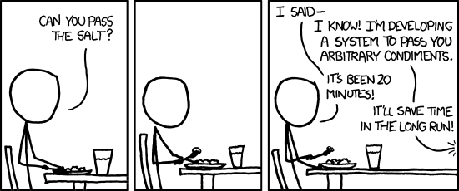
7) Know your problem
Don’t solve a problem that you don’t have to solve.
Use the common sense! Knowledge vs wisdom.
Be careful regarding creating new problems.
/40
Notes:
Get to know the problem that you have to solve. This one has a few aspects into it. Try to understand what is really the problem that you are meant to solve. Sometimes we try to solve other problems, or, in the way of solving a problem, we create a few more problems in other side.
In that aspect, I’d suggest training your common sense. Here there is the joke between what is the difference between KOWNLEDGE and WISDOM.
Knowledge is to know that a tomato is a fruit.
Wisdom is not to put tomato in a fruit salad.
And this apply to what we’ve seen today, it is VERY important to know all of these things we’ve discussed about, but more important is to get the wisdom as to when pay attention to one or the other.

Slide 37
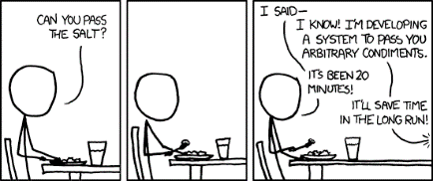

7) Know your problem
Don’t solve a problem that you don’t have to solve.
Use the common sense! Knowledge vs wisdom.
Be careful regarding creating new problems.
Don’t pre-optimize.
Take measurements. Use ‘performance analysis’ tools.
Look at the data. Size? Cache? Entropy?
20/80 rule.
/40
Notes:
Then is the aspect of don’t pre-optimize (as Donald Knuth use to say, pre-optimization is the root to all performance evils).
Nevertheless there is an even more important aspect for this… If you want to make something “go faster”, don’t try and use magic wands to solve the problem.
Take measurements. Try to understand how the data is behaving. Try to understand what is happening in your given system, is it CPU bounded? Is it memory bounded?
And lastly apply the 20/80 rule. 20 percent of the code is executed 80 percent of the time. Optimize that 20 percent and you’ll solve your problem.

Slide 38



7) Know your problem
Don’t solve a problem that you don’t have to solve.
Use the common sense! Knowledge vs wisdom.
Be careful regarding creating new problems.
Don’t pre-optimize.
Take measurements. Use ‘performance analysis’ tools.
Look at the data. Size? Cache? Entropy?
20/80 rule.
Don’t get cozy. AKA Recognize your ignorance.
Go to Watch talks of conferences.
Ask. Try. Learn.
/40
Notes:
And last but not least, don’t assume you know already how to do things. Don’t be afraid of trying to learn more. Get involved. Ask. Try new things. Learn new things.

Slide 39
7 things to know to reduce CPU usage
Know your tools
Knowledge on language, compiler…
Know your hardware: CPU
CPUs are TOO fast.
Know your hardware: memory
L1 cache is fast, main memory is very slow.
Know your numbers
Mathematics, powers of two…
Know your algorithms
Efficiency through algorithms, ‘do only the work you need’.
Know your data structures
Performance through data structures, ‘make your work faster’.
Know your problem
Use your common sense!
/40
Notes:
So I think this could be a good summary of what I consider important to know how to reduce CPU usage.

Slide 40
Thanks!
Any feedback?
Any questions?
/40

